Slide 1

Classification for Early Readmission of Diabetic Patients
Group 9
Nethra Narayanan
Mansi Sain
Zhenan Zhuang
Zhaohan Zhu
Greeshma Janapala

Slide 2

OBJECTIVE
Compare and select the most effective machine learning models, including Logistic Regression, Neural Networks, and K-Nearest Neighbors, for optimal accuracy and reliability.
Assess the impact of Principal Component Analysis (PCA) on model performance, understanding the benefits and limitations of dimensionality reduction.
Utilize cross-validation techniques to ensure the stability and generalizability of our models across different data subsets.
Aim for an optimal balance between precision and computational efficiency, crucial for the models' practical applications.
Make data-driven decisions by analyzing a range of performance metrics to guide our model selection process
Prepare for real-world deployment, ensuring the chosen model is theoretically sound, practical, and adaptable to real-world scenarios.

Slide 3
Table of Contents:
Introduction to Dataset 3
Overview of Dataset 4
Exploratory Data Analytics （EDA） 5
Feature Engineering （Feature Selection, Encoding and PCA） 10
Model Evaluation 13
Conclusion 20

Slide 4
Introduction to Dataset
This dataset contains information on diabetes patients from 130 US hospitals between 1999 and 2008. It was collected to help researchers better understand how to manage diabetes and prevent complications.
There are 50 features and 70000 observations in the dataset.
The Goal of the dataset is to determine the early readmission of the patient within 30 days of discharge.

Slide 5
Overview of Dataset
Patient Demographics: Age, gender, race, ethnicity
01
Diagnoses: Primary and secondary diagnoses related to diabetes and other conditions
02
Medications: Prescribed medications during the hospital stay
03
Laboratory Tests: Results of various blood tests related to diabetes management
04
Readmission Status: Whether the patient was readmitted within 30 days of discharge
05

Slide 6
Exploratory Data Analytics

Slide 7
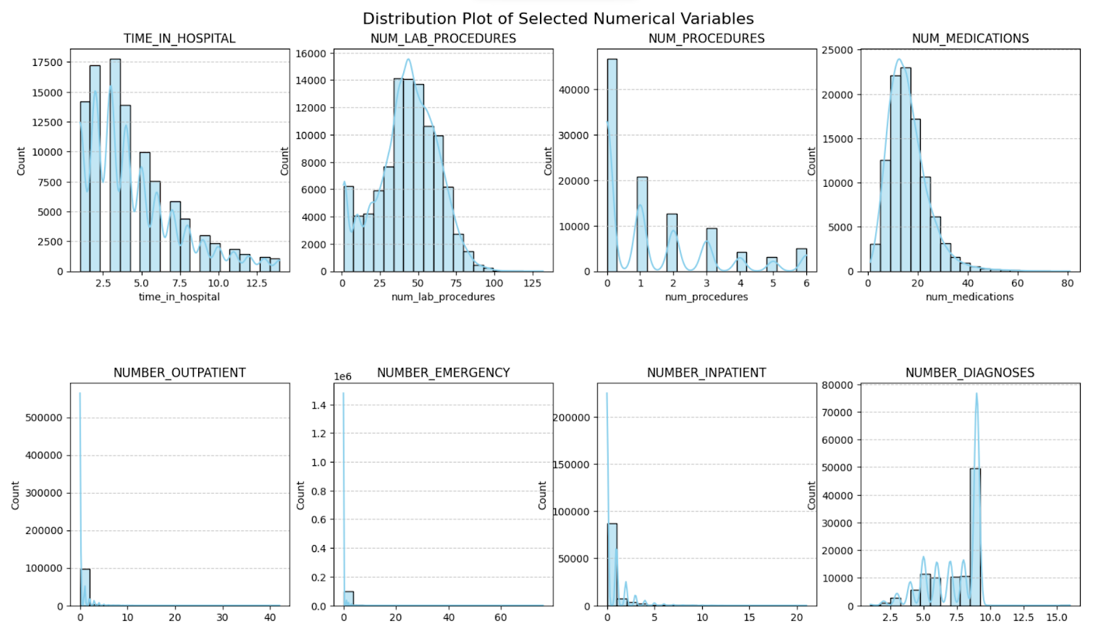

Slide 8
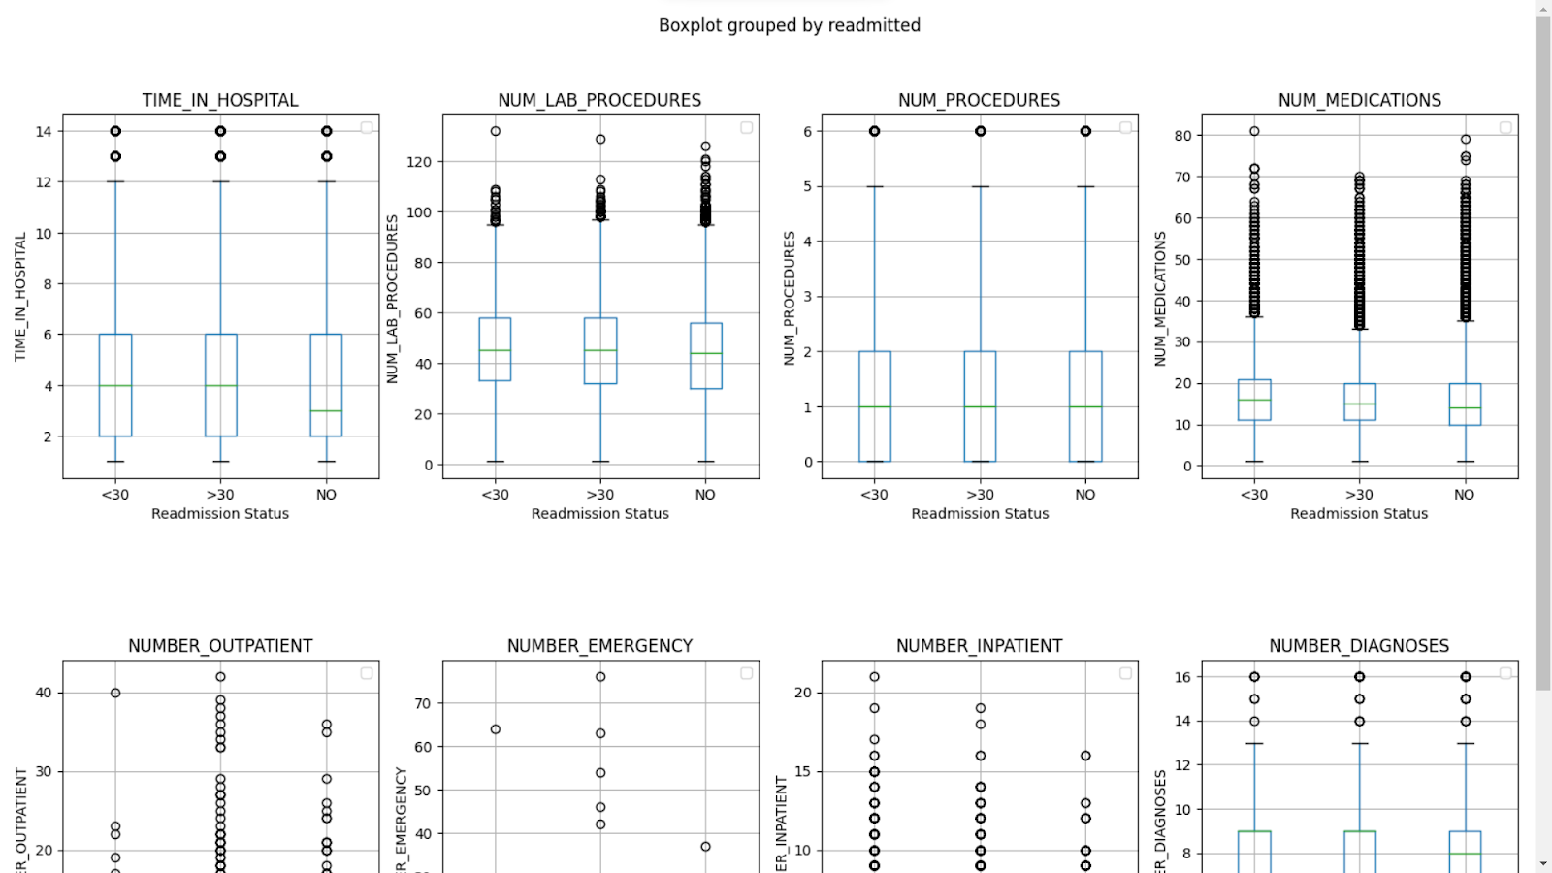

Slide 9
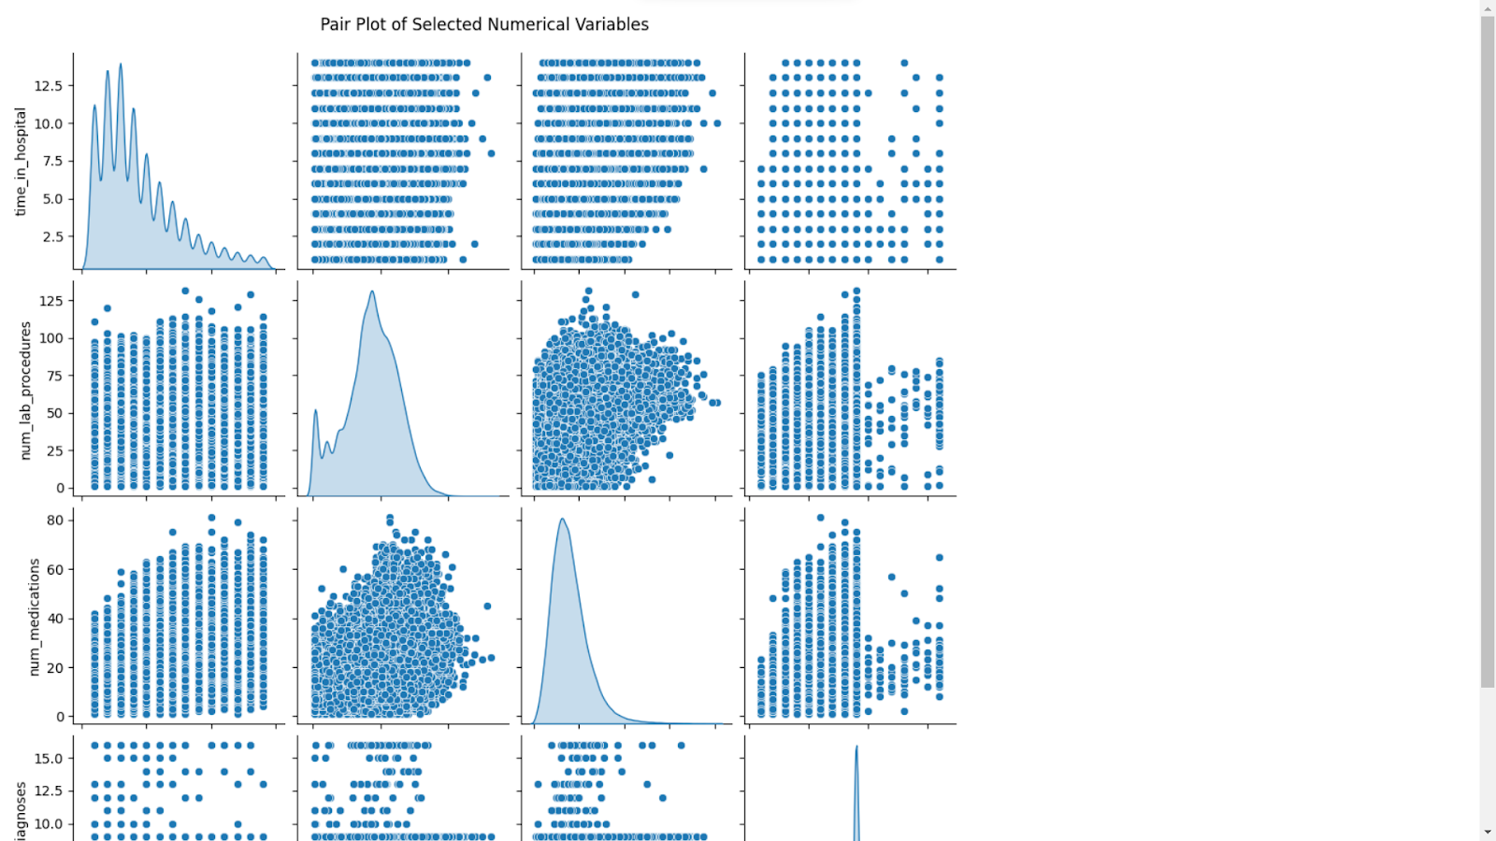

Slide 10
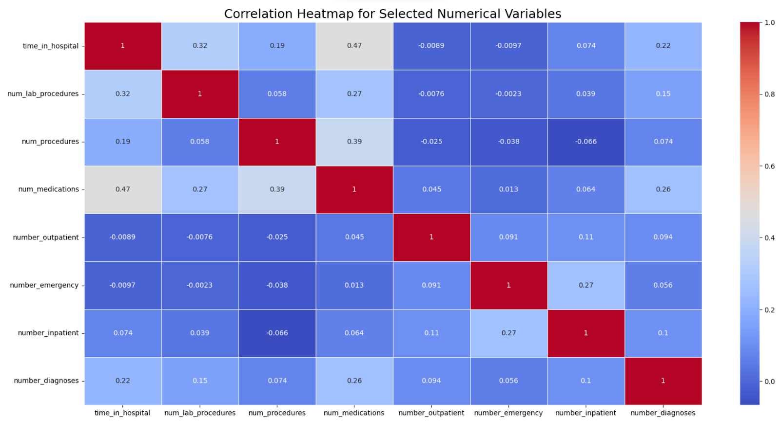

Slide 11
Feature Selection
Dropping Redundant or Invariant Features
Removed columns examide and citoglipton since they contained only one category within the dataset, rendering them uninformative for predictive modeling.
Dropping columns with percentage of missing value greater than 30%
Dropped columns with significant missing data (weight, payer_code, and medical_specialty) to maintain data integrity.
Remapping and Merging Categories
Simplified and reduced the number of categories in admission_type_id, discharge_disposition_id, and admission_source_id by merging similar categories.
Combining Diagnosis Codes
Created a new column diag_cat to classify patients as 'Diabetes' or 'Other', based on whether any of the three diagnosis columns contained a diabetes-related code.

Slide 12

Encoding
Encoding Categorical Variables
Encoding Age as a Numerical Variable
Target Variable(readmitted) Encoding for Binary Classification
Applying One Hot Encoding
Performed One Hot Encoding on several categorical variables to transform them into a format suitable for machine learning algorithms.

Slide 13
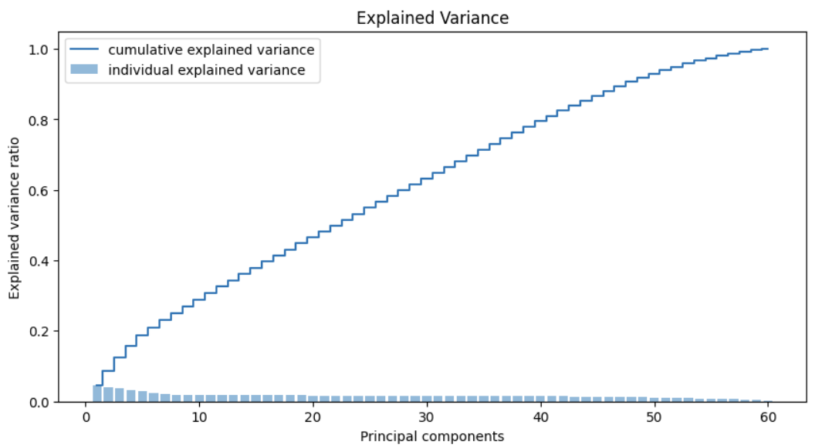
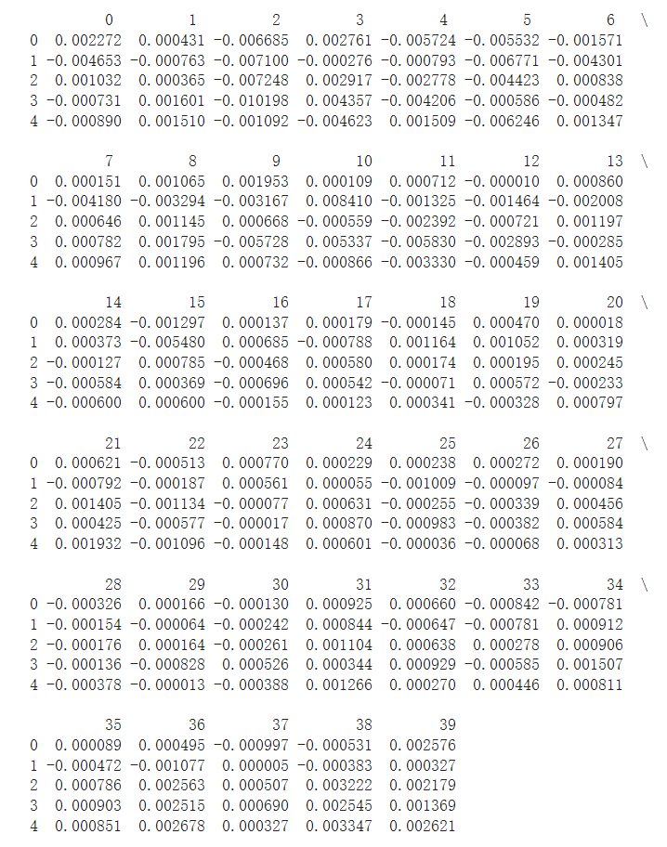
Principal Component Analysis
Objective: to reduce data dimensions while preserving as much variance as possible
Preprocessing:
Fill missing values with column medians
Standardize features by centering to mean and scaling to unit variance
Drop features with correlation > 0.85 to avoid redundancy
PCA Process:
Standardization
Covariance Matrix Computation
Eigendecomposition
Feature Vector Formation
Data Transportation
Result:
Original data transformed into 40 principal components whild keeping 80% of information
Visual representation of variance contribution by each Principal Component

Slide 14
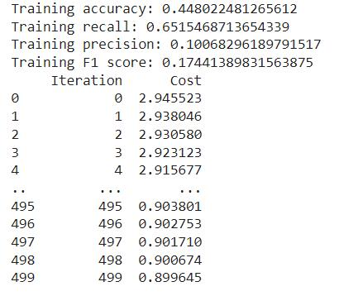
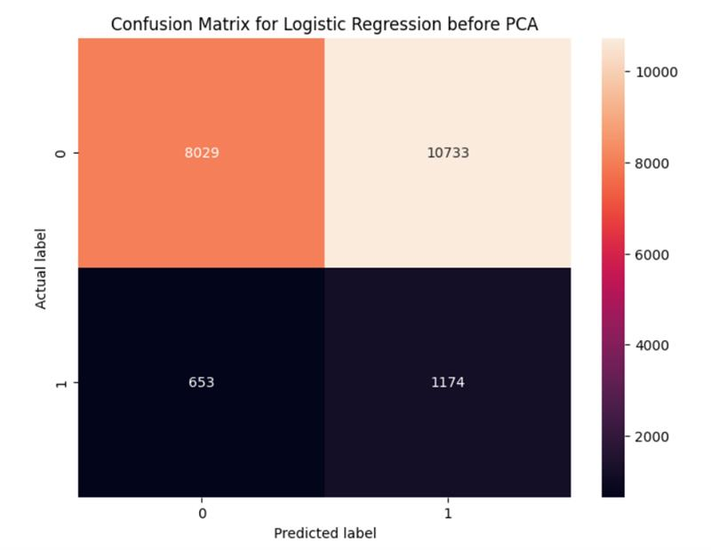
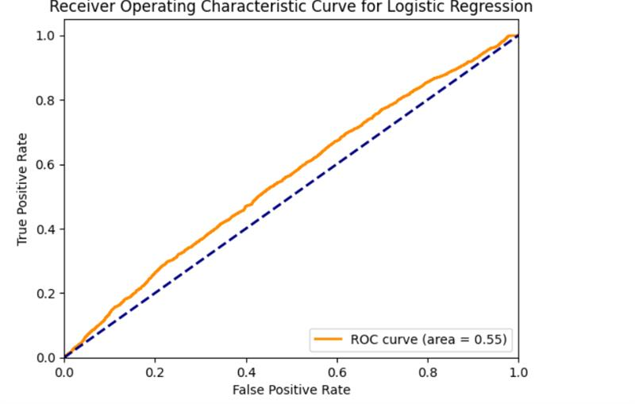
Logistic Regression before PCA

Slide 15
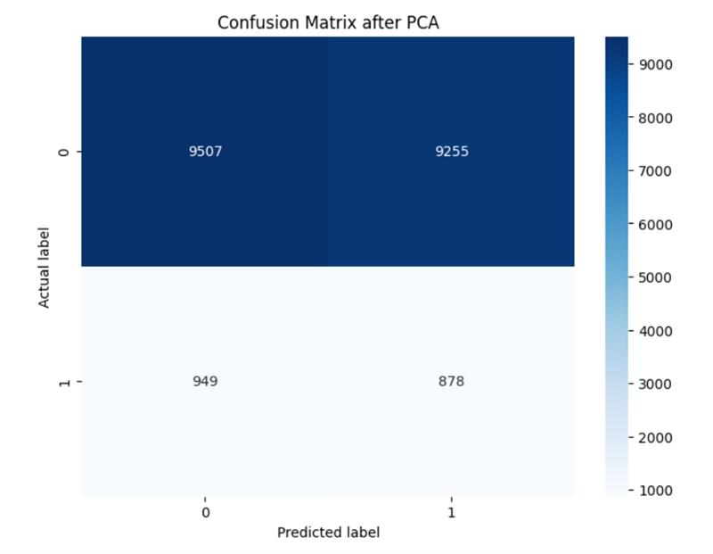
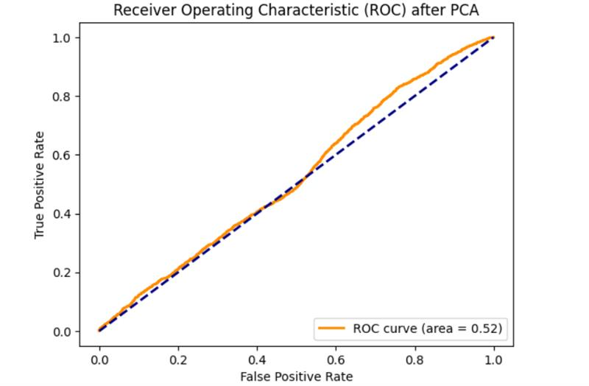

Logistic Regression AFTER PCA

Slide 16
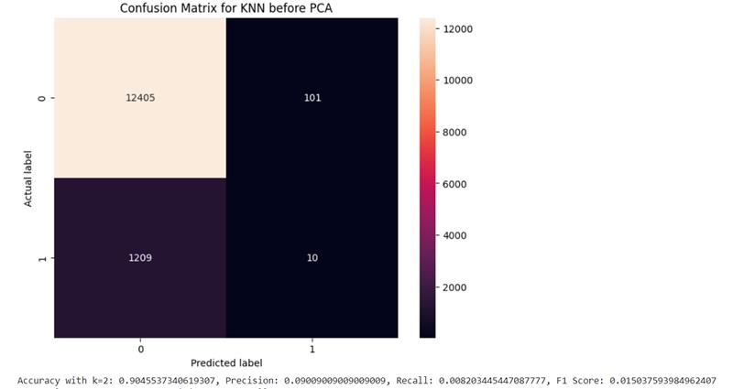
K-NN before PCA:

Slide 17
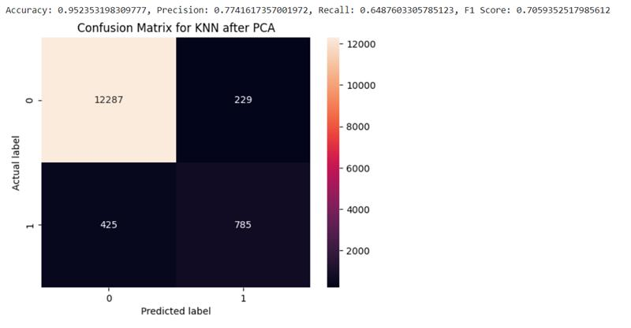
K-NN after PCA:

Slide 18
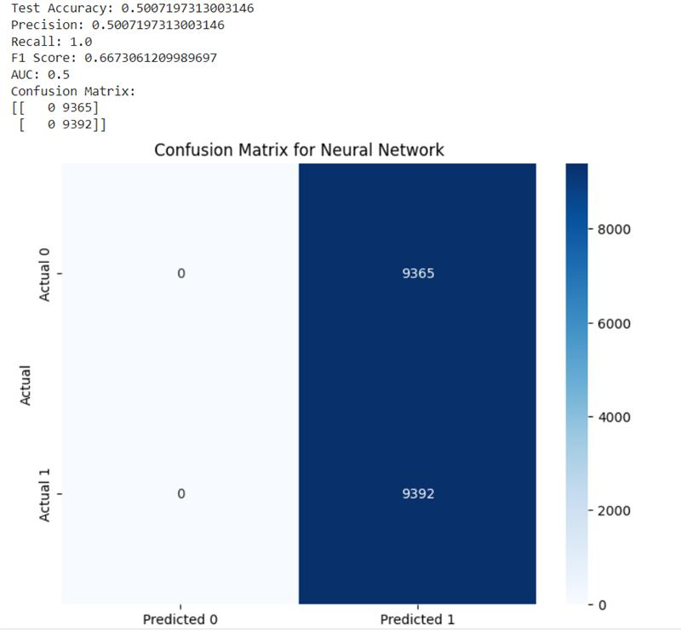
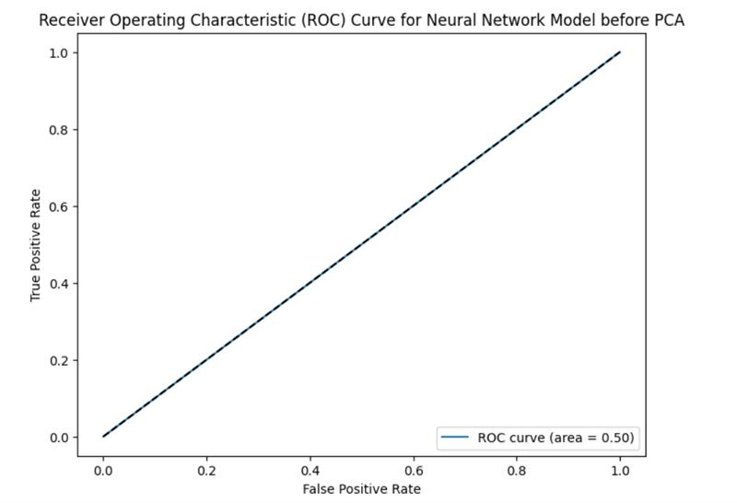
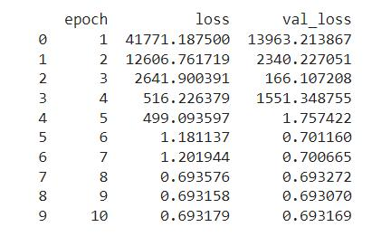
Neural Networks Before PCA:

Slide 19
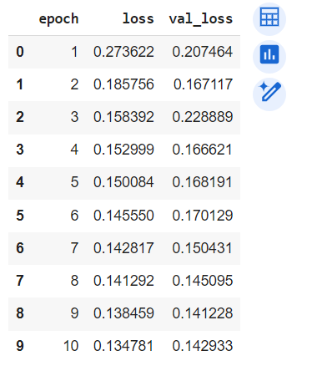
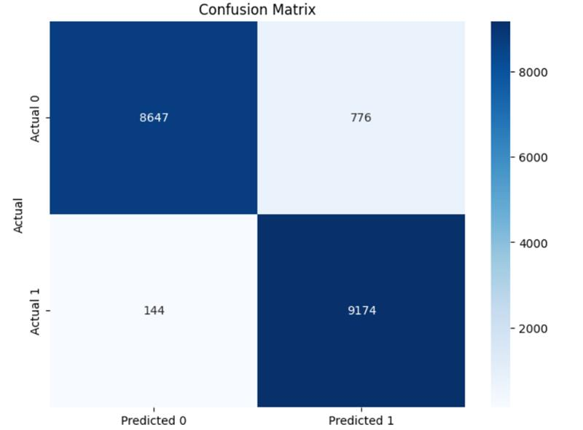
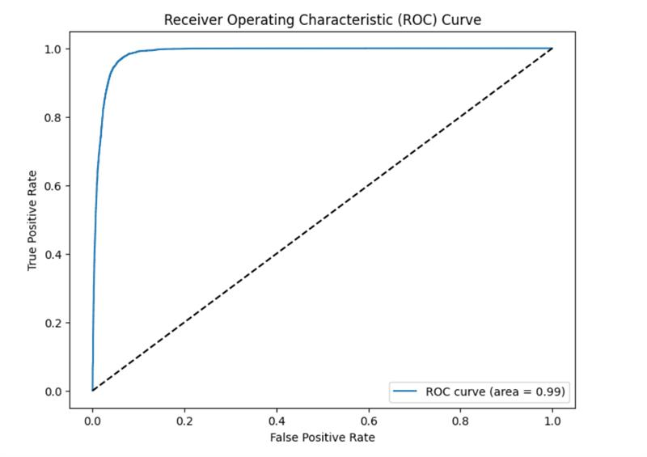
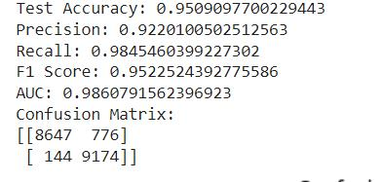
Neural Networks AFTER PCA:

Slide 20
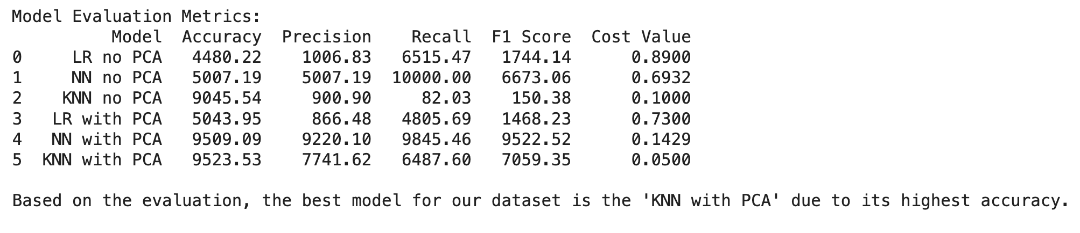
Model Performance and Evaluation

Slide 21

Conclusion
After reviewing these results, we believe that the Neural Network model with PCA (NN with PCA) is the best model for our dataset. It not only has the highest accuracy but also maintains an impressive balance between precision and recall, as evidenced by its high F1 score. The low cost value further reinforces its effectiveness in classification tasks. While the KNN with PCA also shows high accuracy, its precision and recall are not as well-balanced as the NN with PCA, making the latter a more robust choice for our needs.
Taking the cost value into account, the Neural Network with PCA (NN with PCA) still appears to be the best model. It achieves a remarkable balance between high accuracy, precision, recall, and a low cost value, indicating it’s not only making accurate predictions but also doing so in a way that minimizes the cost associated with misclassifications. The KNN with PCA also performs well in terms of cost, but its slightly lower precision and recall compared to the NN with PCA make the latter a more balanced choice overall.

